Slide 1
Normalization

Slide 2
Definition
Database normalization is the process of organizing the fields and tables of a relational database to minimize redundancy and dependency.
Normalization usually involves dividing large tables into smaller (and less redundant) tables and defining relationships between them.
The objective is to isolate data so that additions, deletions, and modifications of a field can be made in just one table and then propagated through the rest of the database via the defined relationships.

Slide 3
Levels of redundancy
File level → Handled by OS
Tuple level → Handled by Primary key/candidate key
Column level → Handled by normalization

Slide 4


How can you define Normalization???
It is used to eliminate redundancy from the database tables.
Normalization is not meant for:
  Eliminating File Level redundancy.
  Eliminating Tuple level redundancy.
  Normalization is meant for:
    Removing Attribute level redundancy.
F1.txt
F1.txt
SID | SNAME | CID | CNAME
S1 | A | C1 | C++
S1 | A | C1 | C++
Primary Key will take care of this thing.

Slide 5
Attribute Level Redundancy……
SID | SNAME | CID | CNAME | FNAME | FID
S1 | A | C1 | C++ | X | F1
S1 | A | C2 | Java | Y | F2
S2 | B | C2 | Java | Y | F2
S3 | C | C1 | C++ | X | F1
S3 | C | C2 | Java | Y | F2
S4 | D | C2 | Java | Y | F2
S5 | E | C2 | Java | Y | F2
S6 | F | C1 | C++ | X | F1
Suppose Faculty teaching JAVA is changed, then…….....
Any Updation required???

Slide 6
Solution………….
Decompose the table into more than one tables.
SID | SNAME | CID
S1 | A | C1
S1 | A | C2
S2 | B | C2
S3 | C | C1
S3 | C | C2
S4 | D | C2
S5 | E | C2
S6 | F | C1
CID | CNAME | FNAME | FID
C1 | C++ | X | F1
C2 | Java | Y | F2

Slide 7
What is anomaly ?
Database anomalies are the problems in relations that occur due to redundancy in the relations.
These anomalies affect the process of inserting, deleting and modifying data in the relations. Some important data may be lost if a Relation is updated that contains database anomalies.
It is important to remove these anomalies in order to perform different processing on the relations without any problem.

Slide 8
Types of Anomalies.
Redundancy
  Repeat info unnecessarily in several tuples/columns
Update anomalies:
  Change info in one tuple but not in another.
Deletion anomalies:
  Delete some values & lose other values too.
Insert anomalies:
  Inserting row means having to insert other, separate info.

Slide 9
Data Redundancy
Data redundancies is nothing, it is duplicacy of data that
means, the same data is stored in different location in a data
base, or if you getting some problem to extract the data from
the file due to duplicacy of data then this cause is called as
redundancies.
It increases storage and decrease performance.
It becomes more difficult to maintain data changes.

Slide 10
Update Anomalies
An update anomaly occurs when we have a lot of redundancy in our data. Due to redundancy, data updating becomes cumbersome.
If we have to update one attribute value, which is occurring a number of times, we have to search for every occurrence of that value and then change it.

Slide 11
student
course
course
Stu_No | Stu_Name | Address | Course_ID
1001 | Amit | Jalandhar | Cap302
1002 | Vikash | Chandigarh | Cap301
1003 | Sumit | ludhiana | Cap303
1004 | Rahul | Jammu | Cap301
1005 | Vijay | Chandigarh | Cap303
Course_ID | Course_Name | Instructor
Cap301 | Data_base | Mr.Sartaj Singh
Cap302 | Operating_System | Mrs. Jasleen
Cap303 | Financial_Management | Mrs. Manpreet Kaur
stu_detail
Stu_No | Stu_Name | Address | Course_ID | Course_Name | Instructor
1001 | Amit | Jalandhar | Cap302 | Operating_System | Mrs. Jasleen
1002 | Vikash | Chandigarh | Cap301 | Data_base | Mr.Sartaj Singh
1003 | Sumit | ludhiana | Cap303 | Financial_Management | Mrs. Manpreet Kaur
1004 | Rahul | Jammu | Cap301 | Data_base | Mr.Sartaj Singh
1005 | Vijay | Chandigarh | Cap303 | Financial_Management | Mrs. Manpreet Kaur

Slide 12
stu_detail
Stu_No | Stu_Name | Address | Course_ID | Course_Name | Instructor
1001 | Amit | Jalandhar | Cap302 | Operating_System | Mrs. Jasleen
1002 | Vikash | Chandigarh | Cap301 | Data_base | Mr.Sartaj Singh
1003 | Sumit | ludhiana | Cap303 | Financial_Management | Mrs. Manpreet Kaur
1004 | Rahul | Jammu | Cap301 | Data_base | Mr. Navdeep Kumar
1005 | Vijay | Chandigarh | Cap303 | Financial_Management | Mrs. Manpreet Kaur
An Update Anomaly exists when one or more instances of duplicated data is updated, but not all i.e Change info in one tuple but not in another.
In STU_DETAIL, if we want to change the name of Instructor of Course_ID cap301 then it will update all the tuples in the table, but some reason all the tuples are not updated, we might have a database that gives two names of instructor for subject cap301.

Slide 13
Insert Anomalies
An insertion anomaly occurs when we are unable to insert a tuple into a table. Such a situation can arise when the value of primary key is not known.
As per the entity integrity rule, the primary key cannot have null value. Therefore, the value/s corresponding to primary key attribute/s of the tuple must be assigned before inserting the tuple.
If these values are unknown, the tuple cannot be inserted into the table.

Slide 14
Delete Anomalies
In case of a deletion anomaly, the deletion of a tuple causes problems in the database.
This can happen when we delete a tuple, which contains an important piece of information, and the tuple being the last one in the table containing the information.
With the deletion of the tuple the important piece of information also gets removed from the database.

Slide 15

Which anomaly is this?

Slide 16

Which anomaly is this?

Slide 17
Dependency
A dependency refers to relationship amongst attributes. These attributes may belong to the same relation or different relations. Dependencies can be of various types viz., functional dependencies, transitive dependencies, multivalued dependencies, join dependencies, etc. We shall briefly examine some of these dependencies.

Slide 18
Types of Dependency
Functional Dependency
  Fully Functional Dependency
  Partial Functional Dependency
Transitive Dependency
Multivalued Dependency
Join Dependency

Slide 19
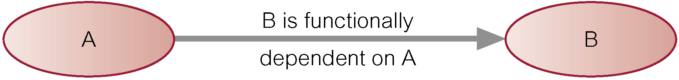
Functional Dependency
Functional Dependency (F.D) – Functional dependency represents semantic association between attributes. If a value of an attribute A determines the value of another attribute B, we say B is functionally dependent on A. This is denoted by
A => B and read as “A determines B” and A is called the determinant

Slide 20
Course_Name and Instructors are dependent on
Course_ID
course
Course_ID | Course_Name | Instructors
Cap301 | Data_base | Mr.Sartaj Singh
Cap302 | Operating_System | Mrs. Jasleen
Cap303 | Financial_Management | Mrs. Manpreet Kaur

Slide 21
Fully Functional Dependency
Fully Functional dependency Indicates that if A and B are attributes(columns)of a table, B is fully functional dependent on A, if B is functionally dependent on A ,but not on any proper subset of A.
E.g. Staff_ID----> Domain
Examples: For example, “{SCN, age} -> name” is a functional dependency, but it is not a full functional dependency because you can remove age from the left side of the statement without impacting the dependency relationship

Slide 22
Partial Functional Dependency
Partial Functional Dependency Indicates that if A and B are attributes of a table , B is partially dependent on A if there is some attribute that can be removed from A and yet the dependency still holds.
Say for Ex, consider the following functional dependency that exists in the STUDENT table:
Reg_no, Name -------> Section_No
Section_No is functionally dependent on a subset of A
(Reg_no, Name ), namely Reg_no.

Slide 23
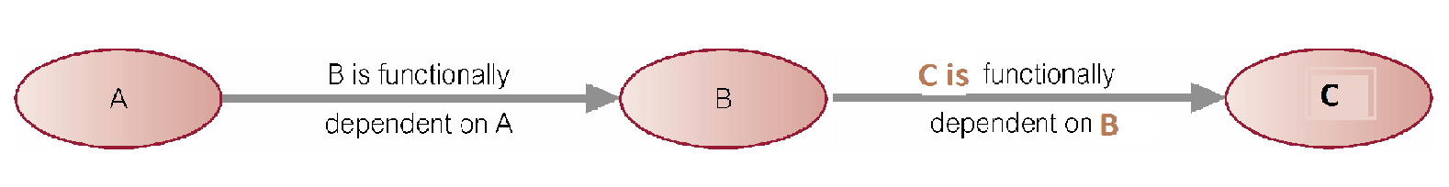
Transitive Dependency
Transitive Dependency –
Transitive dependency is a form of intermediate dependency. For example, if we have attributes or groups of attributes A, B and C such that A determines B and B determines C i.e.
A => B
B => C
Then we say a transitive dependency represented by A => B => C
C is transitively dependent on A through B.

Slide 24
Multi-valued Dependency
Multi-valued Dependency refers to m:n (many-to-many) relationships.
We say multi-valued dependency exists between two data items when one value of the first data item gives a collection of values of the second data item i.e., it multi-determines the second data items.
For example, imagine a car company that manufactures many models of car, but always makes both red and blue colors of each model. If you have a table that contains the model name, color and year of each car the company manufactures, there is a multivalued dependency in that table. If there is a row for a certain model name and year in blue, there must also be a similar row corresponding to the red version of that same car.

Slide 25
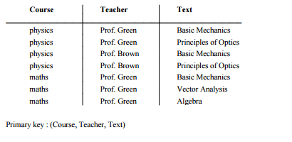
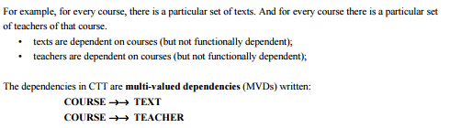

Slide 26
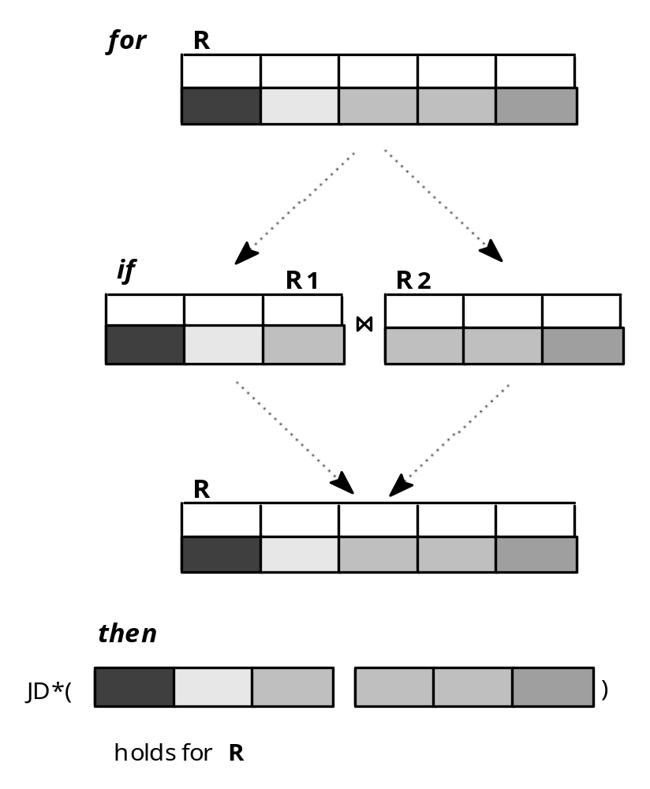
Join Dependency
JD * (R₁, R₂, R₃, ..., R_{m}) holds in R iff R = join (R₁, R₂, R₃, ..., R_{m} ), R_{i} - a projection of R

Slide 27
Decomposition???
Splitting the relation into two or more sub-relations.
Decomposition can be of two types:
  Loss Less Join Decomposition.
  Dependency preserve Decomposition.
A | B
1 | 1
2 | 1
3 | 2
A | B | C
1 | 1 | 2
2 | 1 | 1
3 | 2 | 2
B | C
1 | 2
1 | 1
2 | 2

Slide 28
A | B
1 | 1
2 | 1
3 | 2
A | B | C
1 | 1 | 2
1 | 1 | 1
2 | 1 | 2
2 | 1 | 1
3 | 2 | 2
A | B | C
1 | 1 | 2
2 | 1 | 1
3 | 2 | 2
B | C
1 | 2
1 | 1
2 | 2
R1 JOIN R2 Ↄ R
Lossy JOIN Decomposition

Slide 29
A | B
1 | 1
2 | 1
3 | 2
A | B | C
1 | 1 | 2
2 | 1 | 1
3 | 2 | 2
A | B | C
1 | 1 | 2
2 | 1 | 1
3 | 2 | 2
A | C
1 | 2
2 | 1
3 | 2
R1 JOIN R2 = R
Loss-Less JOIN Decomposition

Slide 30
Normal Forms
The normal forms (abbrev. NF) of relational database theory provide criteria for determining a table's degree of vulnerability to logical inconsistencies and anomalies.
The higher the normal form applicable to a table, the less vulnerable it is to inconsistencies and anomalies.
Each table has a "highest normal form" (HNF): by definition, a table always meets the requirements of its HNF and of all normal forms lower than its HNF.

Slide 31
1NF
A relation is said to be in First Normal Form (1NF) if and only if every entry of the relation (the intersection of a tuple and a column) has at most a single value.
In other words “a relation is in First Normal Form if and only if all underlying domains contain atomic values or single value only

Slide 32
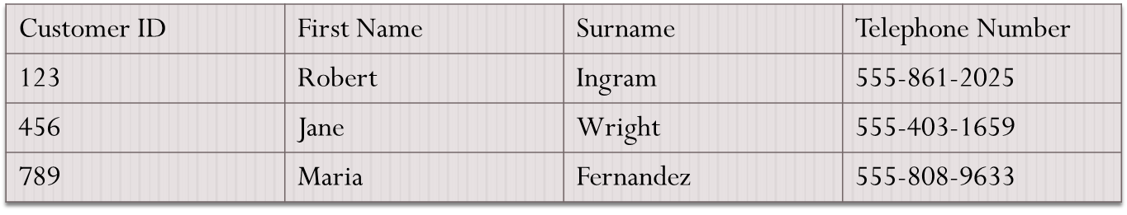
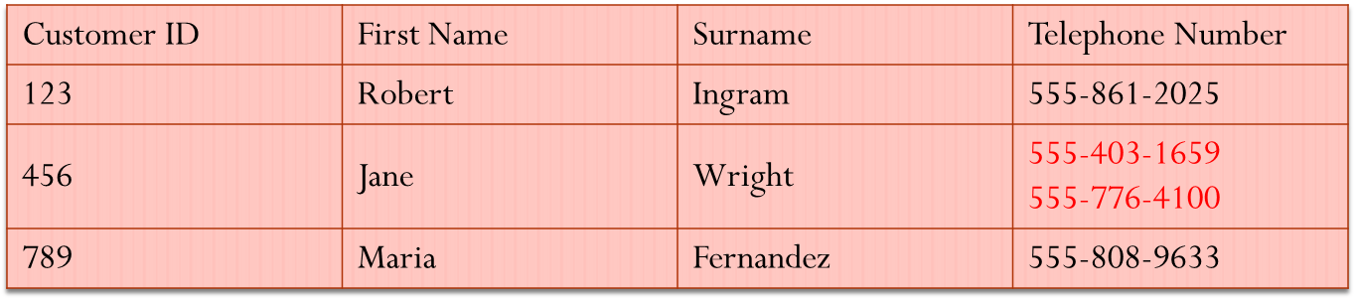
Example
Suppose a designer wishes to record the names and telephone numbers of customers. He defines a customer table which looks like this
Customer
The designer then becomes aware of a requirement to record multiple telephone numbers for some customers. He reasons that the simplest way of doing this is to allow the "Telephone Number" field in any given record to contain more than one value
Customer

Slide 33
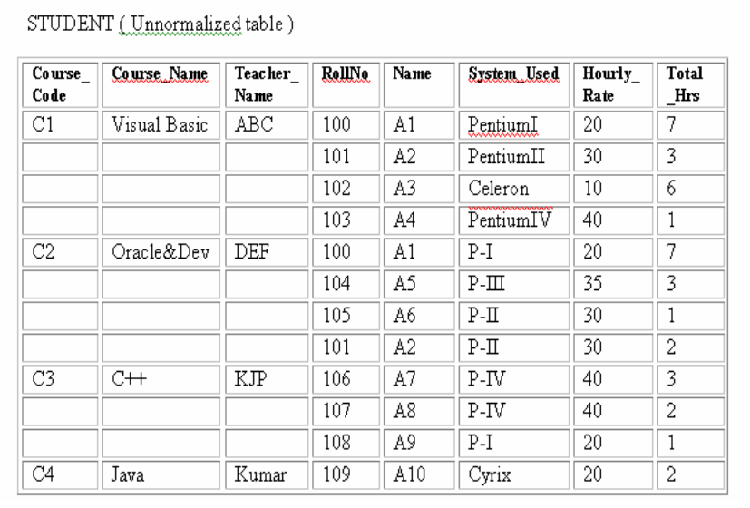
Another example

Slide 34
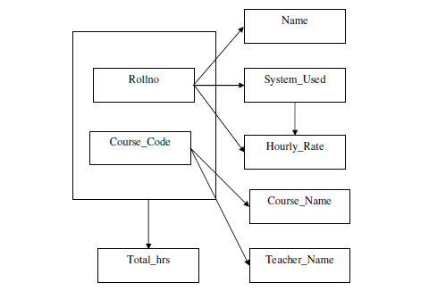
Dependencies in given table

Slide 35
First Approach: Flattening the table
The first approach known as “flattening the table” removes repeating groups by filling in the “missing” entries of each “incomplete row” of the table with copies of their corresponding non-repeating attributes.

Slide 36
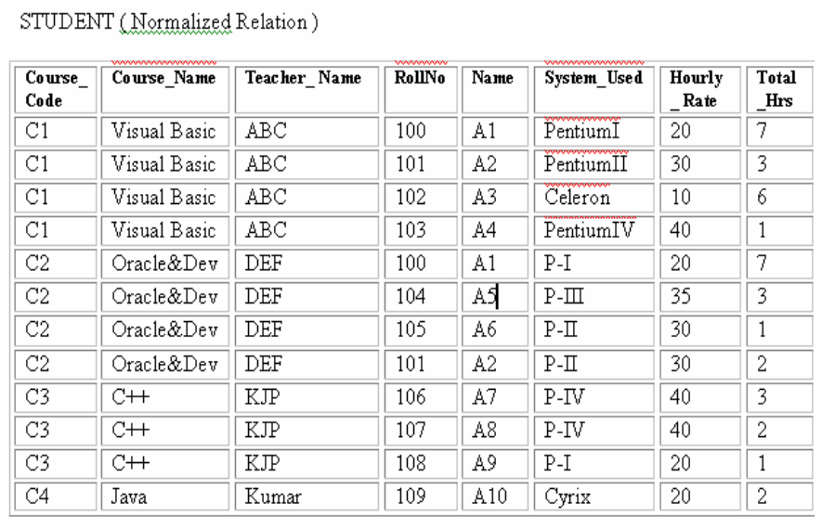

Slide 37
Second Approach: Decomposition of the table
The second approach for normalizing a table requires that the table be decomposed into two new tables that will replace the original table.
However, before decomposing the original table it is necessary to identify an attribute or a set of its attributes that can be used as table identifiers

Slide 38
Rules for decomposition
One of the two tables contains the table identifier of the original table and all the non-repeating attributes.
The other table contains a copy of the table identifier and all the repeating attributes.

Slide 39
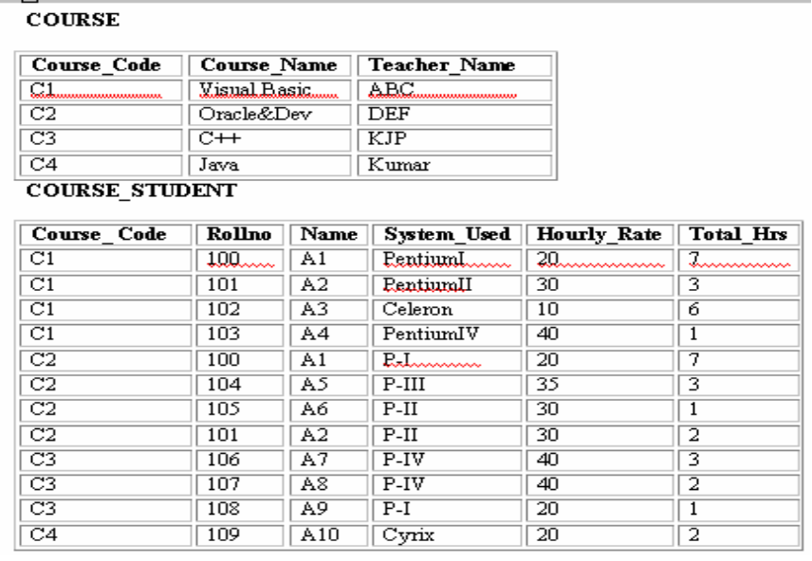

Slide 40
Anomalies in 1NF
Insert anomaly:
  Cannot insert the information about a student until he/she joins any course
  Cannot insert the information about course until there is a student who enroll in that course
Delete anomaly
  Whenever we delete the last tuple of a particular student. Other information may also be deleted
Update anomaly
  Forgets to make changes in all tables.

Slide 41
2NF
Second normal form (2NF) a relation in first normal form in which every non key attribute is fully functionally dependent on the primary key.
A Table is said to be in 2NF if
  it is in 1NF and
  there are no partial dependencies i.e. every non primary key attribute of the Table is fully functionally dependent on the primary key.

Slide 42
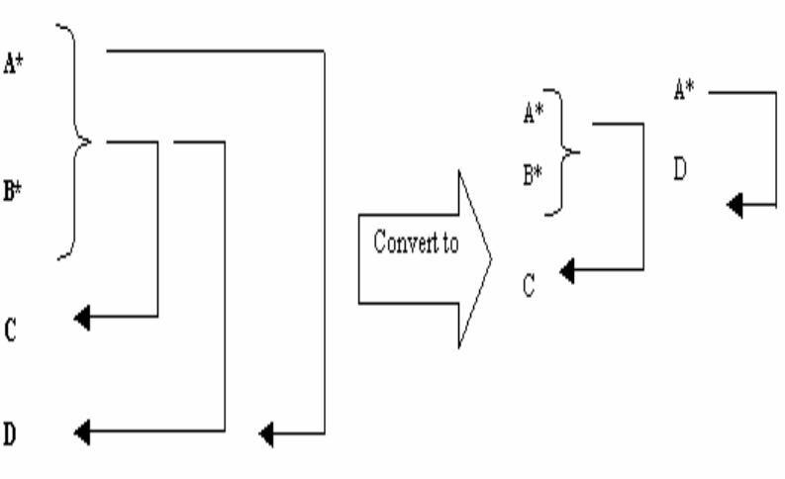
Rules for converting 1 NF into 2NF

Slide 43
Non-key attributes Name, System_Used and Hourly_Rate are not fully dependent on the primary key (Course_Code, Rollno)
Because Name, System_Used and Hourly_Rate are functional dependent on Rollno and Rollno is a subset of the primary key so it does not hold the law of fully functional dependence.

Slide 44
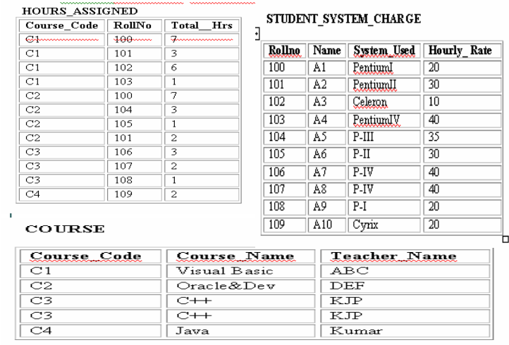

Slide 45
Data Anomalies in 2NF Relations
Insert anomaly :
  We want to set in advance the rate of a system. We cannot insert it until there is a student assign to that system.
  But its obvious thing that the rate that is charged from student for a particular system is independent of whether or not any student uses that system.
Delete anomaly
Update anomaly:
  If several students are working on same type of system and we want to change the hourly rate, then we have to make changes in all locations.

Slide 46
Third NF (3NF)
A relation R is in Third Normal Form (3NF) if and only if the following conditions are satisfied simultaneously:
  (1) R is already in 2NF
  (2) No nonprime attribute is transitively dependent on the key.
Another way of expressing the conditions for Third Normal Form is as follows:
  (1) R is already in 2NF
  (2) No nonprime attribute functionally determines any other nonprime attribute.
These two sets of conditions are equivalent.

Slide 47
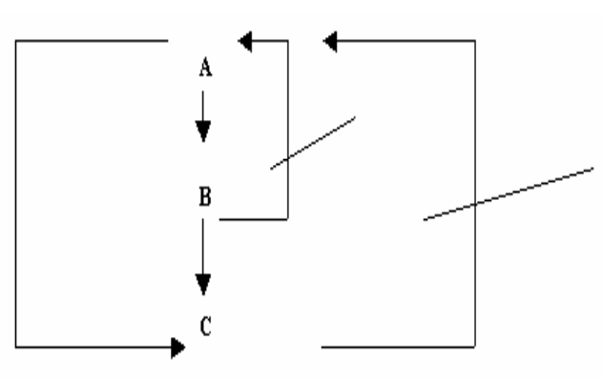

Slide 48
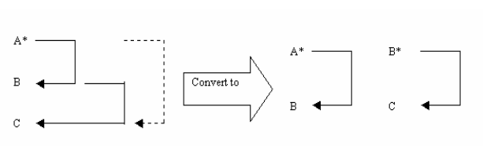
Rule for converting a relation in 3NF

Slide 49
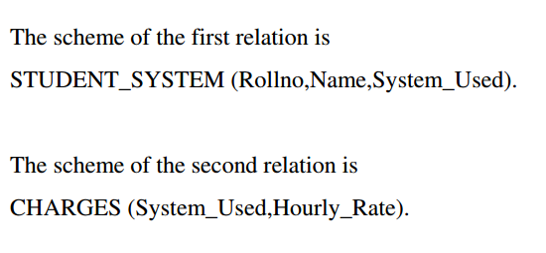

Slide 50
2NF

Slide 51
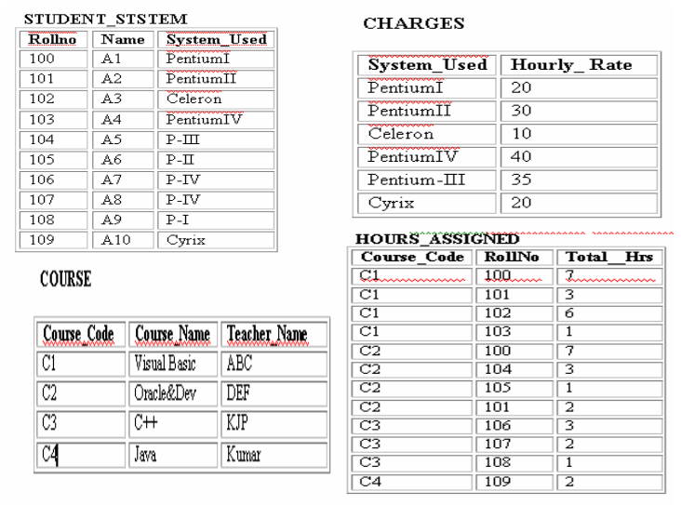

Slide 52
BCNF (Boyce Codd NF)
BCNF is a stronger form than 3NF.
BCNF makes no explicit reference to first, second normal forms (nor the concept of functional and transitive dependencies).
BCNF states that
  A relation R is in BCNF if and only if every determinant is a candidate key.

Slide 53
We will consider three cases :
  Case 1: Table is not in 3NF , also not in BCNF
  Case 2: Table is in 3NF as well as in BCNF
  Case 3: Table is in 3NF, but not in BCNF.
After this , we will discuss how we can convert a table from 3NF to BCNF

Slide 54
Similarities between 3NF and BCNF
Relation (student_system_charge) in 2NF , not in 3NF, also not in BCNF

Slide 55
In student_system_charge
  Rollno → name, system_used,hourly_rate
  System_used → Hourly_rate
  In this relation, there is transitive dependency.
  So it is not in 3NF.
  System_used is a determinant but is not a key.
  So relation is not in BCNF.

Slide 56
Consider 3NF

Slide 57
Here in each relation, every determinant is unique(i.e. key) in its corresponding relation.
So this relation is also in BCNF.
Only single candidate key → BCNF as well as 3NF

Slide 58
4NF
Fourth Normal Form (4NF) 4NF is a stronger normal form than BCNF as it prevents Tables from containing Multi-Valued Dependencies (MVDs) and hence data redundancy.
The Normalization of BCNF Tables to 4NF involves the removal of MVDs from the Table by placing the attribute(s) in a new Table along with the copy of the determinant(s).

Slide 59
4th Normal Form (4NF)
Stronger than 3NF and BCNF
A relation R is in Fourth Normal Form (4NF) if and only if the following conditions are satisfied simultaneously:
  R is already in 3NF or BCNF.
  If it contains no multi-valued dependencies.

Slide 60
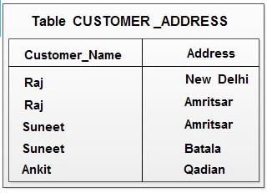
MVDs (Multi valued dependency)
MVD is the dependency where one attribute value is potentially a 'multi-valued fact' about another.
Consider the table
Raj → New Delhi, Amritsar
Amritsar → Raj, suneet
Customer_name : Address
1 : N
Address : Customer_name
1 : N
Means N : N relationship

Slide 61
Fourth Normal Form (4NF) - MVD
Dependency between attributes (for example, A, B, and C) in a relation, such that for each value of A there is a set of values for B and a set of values for C
MVD between attributes A, B, and C in a relation using the following notation:
  A ⎯⎯➢➢ B
  A ⎯⎯➢➢ C
Deepak Gour, Faculty – DBMS, School of Engineering, SPSU

Slide 62
This table will be in the fourth normal form if B and C dependent on each other.
However if B and C are independent of each other then R is not in fourth normal form as MVD exists.
In order for a table to contain MVD, it must have three or more attributes.

Slide 63
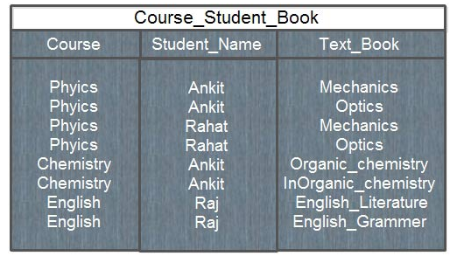
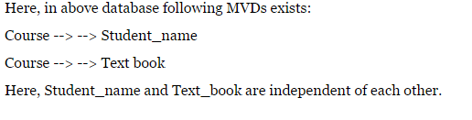

Slide 64
Rule to convert 3NF or BCNF into 4NF
A relation R having A, B, and C, as attributes can be non loss-decomposed into two projections R1(A,B) and R2(A,C) if and only if the MVD A--> --> B|C hold in R.
Looking again at COURSE_STUDENT_BOOK table, it contains a multi-valued dependency as shown below:
  Course ---> --> Student_name
  Course ---> --> Text_book
To put it into 4NF, two separate tables are formed as shown below:
  COURSE_STUDENT (Course, Student_name)
  COURSE_BOOK (Course, text_book)

Slide 65
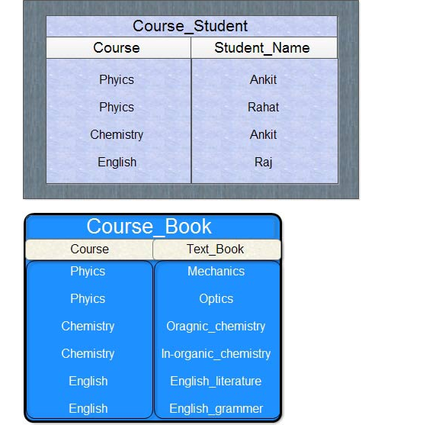

Slide 66
5th Normal Form
Fifth Normal Form(5NF) 5NF is also called Project-Join Normal Form(PJNF) and specifies that a 5NF Table has no Join dependency.
Formally, A table is said to be in 5NF if and only if
  Table is already in 4NF
  It cannot be further non-loss decomposed.

Slide 67
Lossless and lossy decomposition
A decomposition {R1,R2,….Rn} of a relation R is called as a Lossless if the natural join of R1,R2,….Rn produces exactly the same relation R
A decomposition {R1,R2,….Rn} of a relation R is called as a Lossy if the natural join of R1,R2,….Rn does not produce exactly the same relation R

Slide 68
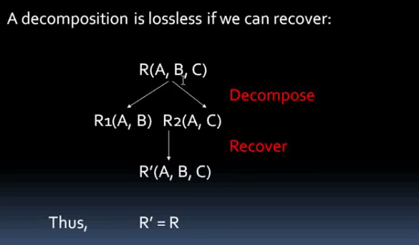

Slide 69
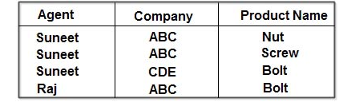
Consider the table
AGENT_COMPANY_PRODUCT (Agent, Company, Product _Name)

Slide 70
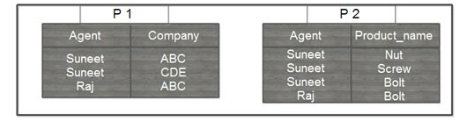
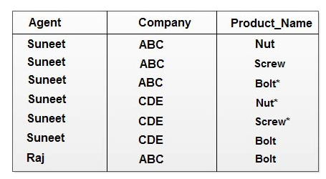

Slide 71
Consider another decomposition
Company | Product_name
ABC | Nut
ABC | Screw
ABC | Bolt
CDE | Bolt
Agent | Company | Product_name
Suneet | ABC | Nut
Suneet | ABC | Screw
Suneet | ABC | Bolt*
Suneet | CDE | Bolt
Raj | ABC | Bolt
P3
Join of P1, P2 and P3

Slide 72
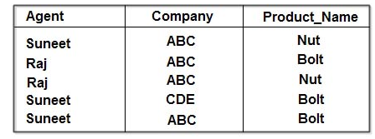
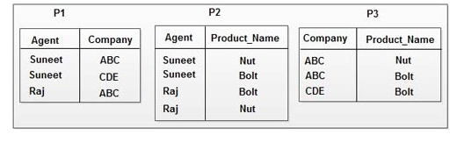
Consider another table

Slide 73
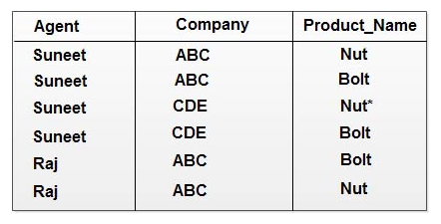
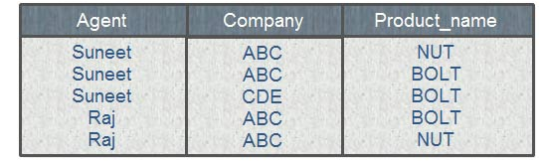
Join of P1 and P2
Join of P1, P2 and P3

Slide 74
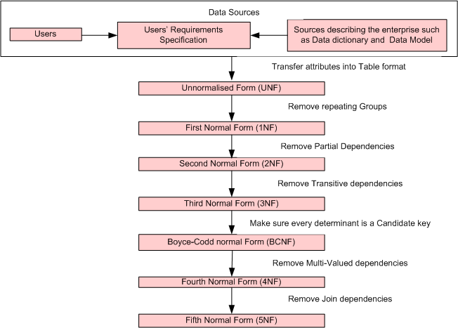

Slide 75
Pitfalls in Relational Database Design
Relational database design is prone to many possible errors.
Creating an effective design for a relational database is a key element in building a reliable system. There is no one "correct" relational database design for any particular project, and developers must make choices to create a design that will work efficiently. There are a few common design pitfalls that can harm a database system. Watching out for these errors at the design stage can help to avoid problems later on.
1. Careless Naming Practices
Choosing names is an aspect of database design that is often neglected but can have a considerable impact on usability and future development. To avoid this, both table and column names should be chosen to be meaningful and to conform to the established conventions, ensuring that consistency is maintained throughout a system. A number of conventions can be used in relational database names, including the following two examples for a record storing a client name: "client_name" and "clientName."

Slide 76
2. Lack of Documentation
Creating documentation for a relational database can be a vital step in safeguarding future development. There are different levels of documentation that can be created for databases, and some database management systems are able to generate the documentation automatically. For projects where formal documentation is not considered necessary, simply including comments within the SQL code can be helpful.
3. Failure to Normalize
Normalization is a technique for analyzing, and improving on, an initial database design. A variety of techniques are involved, including identifying features of a database design that may compromise data integrity, for example items of data that are stored in more than one place. Normalization identifies anomalies in a database design, and can preempt design features that will cause problems when data is queried, inserted or updated.

Slide 77
4. Lack of Testing
Failure to test a database design with a sample of real, or realistic, data can cause serious problems in a database system. Generally, relational database design is started from an abstract level, using modeling techniques to arrive at a design. The drawback to this process is that the design sometimes will not relate accurately to the actual data, which is why testing is so important.
5. Failure to Exploit SQL Facilities
SQL has many capabilities that can improve the usability and success of a database system. Facilities such as stored procedures and integrity checks are often not used in cases where they could greatly enhance the stability of a system. Developers often choose not to carry out these processes during the design stages of a project as they are not a necessity, but they can help to avoid problems at a later stage.

